Slide 1



A PROJECT REPORT ON
MULTI ORGAN HARVESTING AID NETWORK (MOHAN) FOUNDATION

Slide 2

What is Organ Donation?
Organ donation is the process is a surgical operation in which a failure or damaged organ in human body is removed and replaced with a functioning one.
The donor may be a deceased donor or a living donor.

Slide 3

In 1994, The transplantation of human organs act (THOA) was promulgated by the government of India. Moreover, the transplantation of human organs rules followed in 1995 and was last amended in 2014, increasing the scope of donation and including tissues for transplantation.
the act made the commercialization of organs a punishable offense and legalized the concept of brain death in India allowing deceased donation by obtaining organs from brain stem dead person.

Slide 4
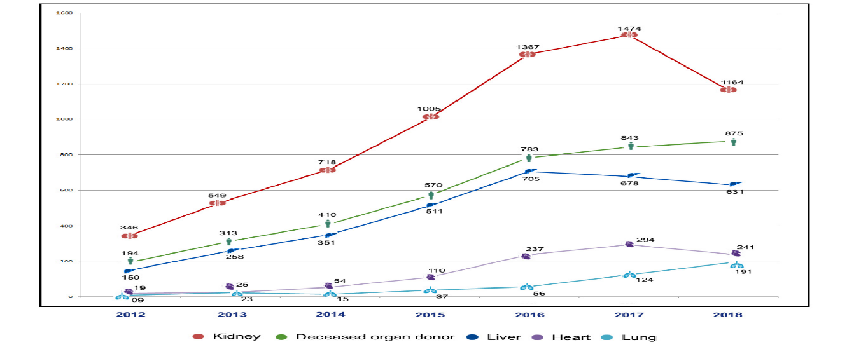
Study of number of organ donations and transplantations from 2012 to 2018

Slide 5


ABOUT MOHAN FOUNDATION

Slide 6
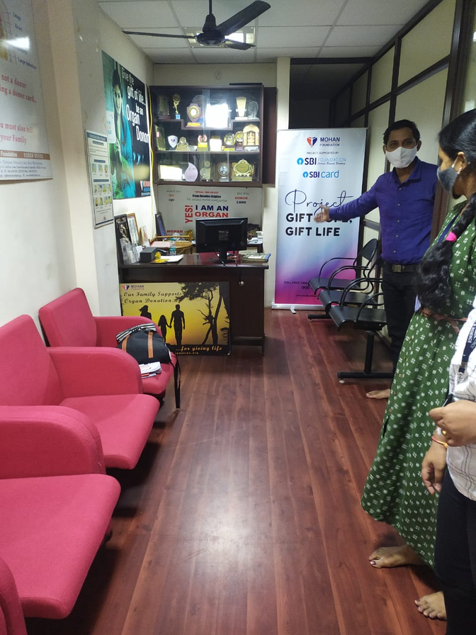
Mohan Foundation is a non-profitable Organization, a registered non-government charity organization in India that works in the field of deceased organ donation and transplantation. Mohan is an acronym for Multi-Organ Harvesting Aid Network.
This Foundation has started to bring the awareness of transplantation by both medical and non -medical professionals.
Mission of Mohan Foundation is to "Gift of life through a life saving organ for those who are suffering from organ failure".

Slide 7
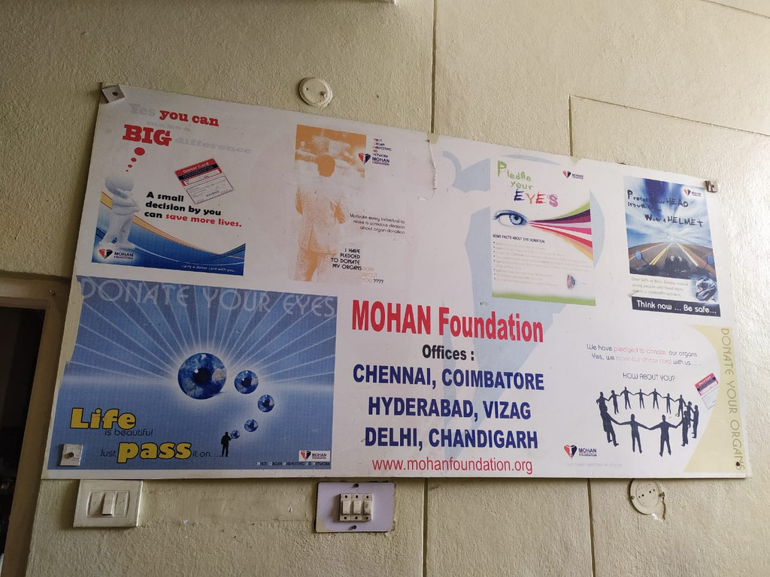
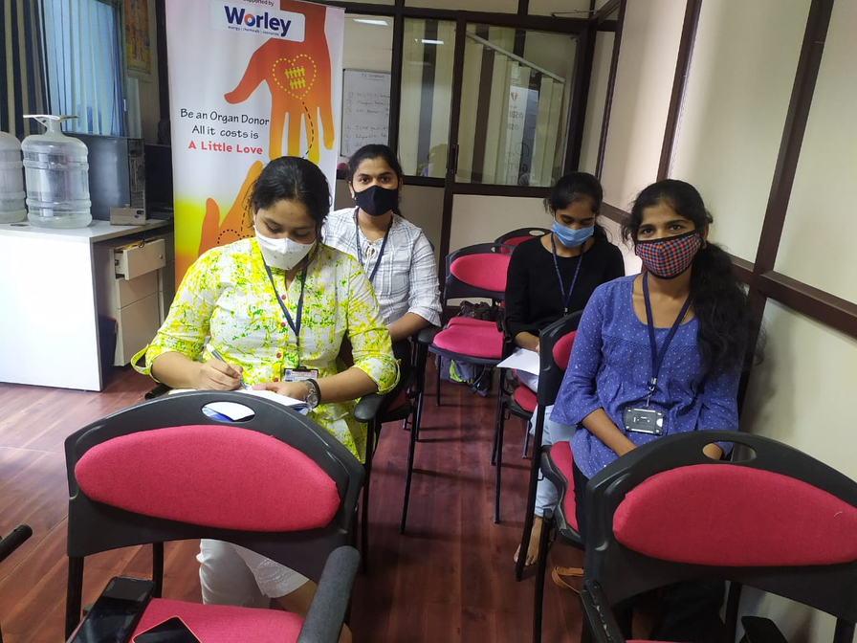

Slide 8

METHODOLOGY
Networking with the hospitals to enable donation to occur
Training Transplant Coordinators in counselling families of the deceased for enable more donations

Slide 9

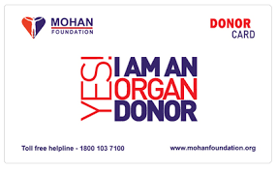
Any person willing to donate his/her organs can do so by filling out the donor consent form available on the website (www.mohfw.nic.in/).
This is a voluntary act.
The donor may also approach a transplant center or other organ donation organization for a donar card

Slide 10

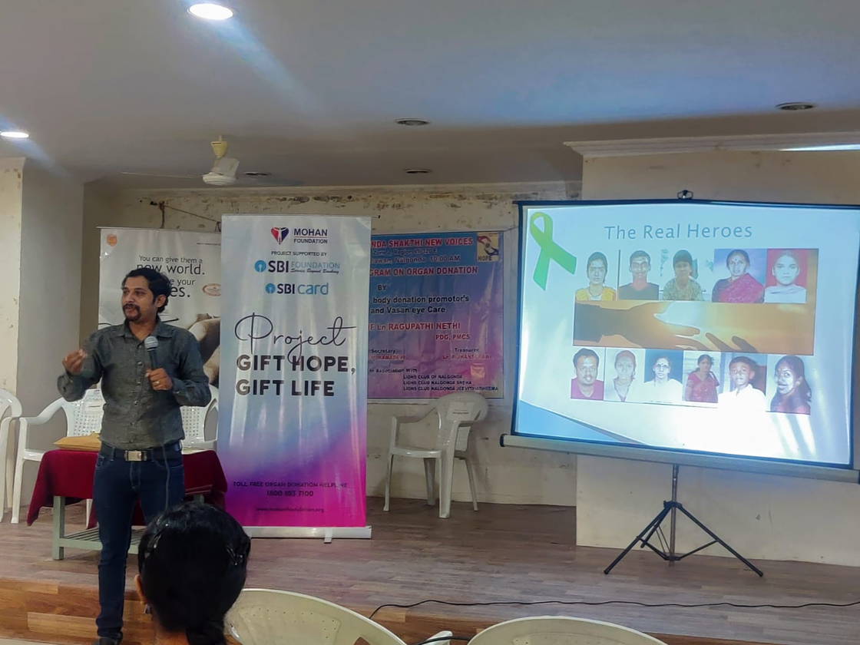
Awareness
The Foundation regularly conducts public awareness programs for corporate employees, students,medical professionals, etc.
Mohan Foundation believes in engaging the youth and school students and strongly feels that they are an excellent resource for increasing awareness on organ donation.
They are engaging high school teachers and college lecturers to get involved in their training programs and to use the educational material to reinforce in their class room and include organ donation in their school health affairs .

Slide 11
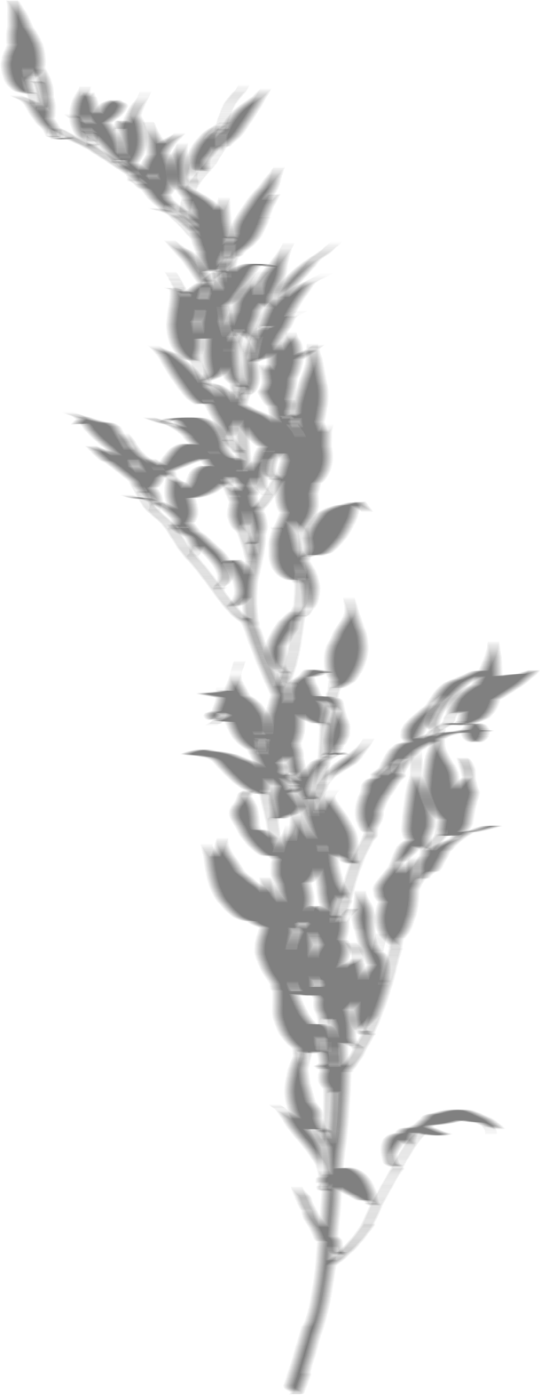
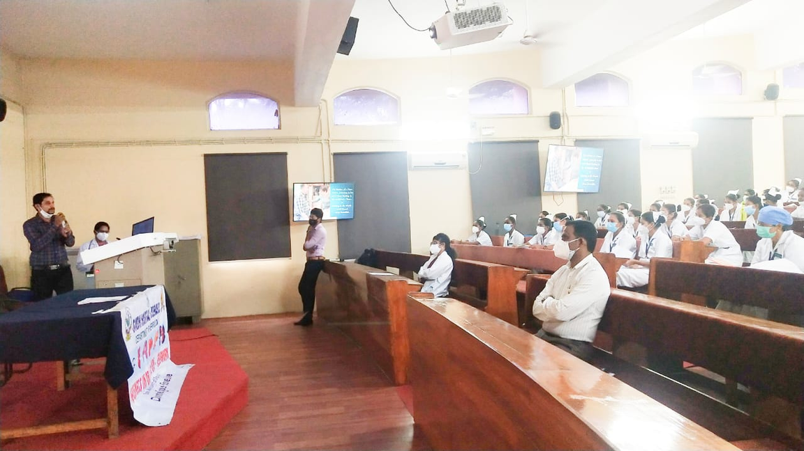
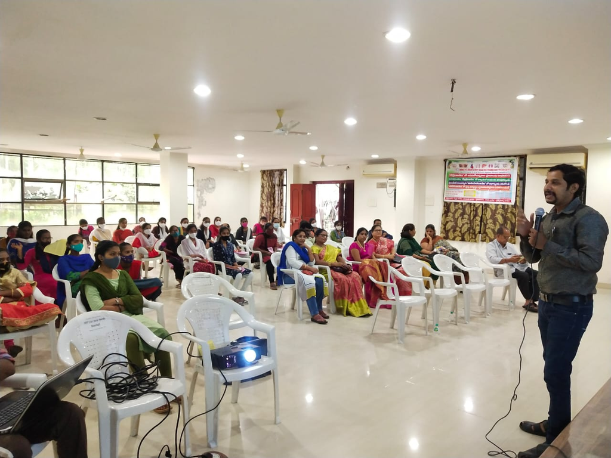

Slide 12
living donor
cadaver donar
1. heart
2. lungs
3. pancreas
4.eye
1.liver
2.kidney
3.skin(mesh)
4.bone marrow

Slide 13
01
A person must be unconscious and fail to respond to outside stimulation
BRAIN
DEAD
02
A person's heartbeat and breathing can only be maintained using a ventilator
03
There must be clear evidence that serious brain damage has occurred and it cannot be cured.

Slide 14

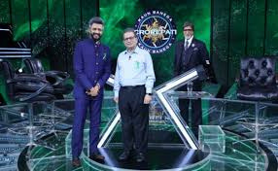
ACHIEVEMENTS
Dr.Sunil Shiroff,Managing Trustee, MOHAN Foundation, have been honored to meet Mr.Amitab Bachchan and Mr.Rittesh Deshmukh
at KBC.

Slide 15

CONCLUSION
After the visit, we have understood the process & challenges before or during Organ donation and transplantation
We must understand the necessity behind organ donation and support it.

Slide 16
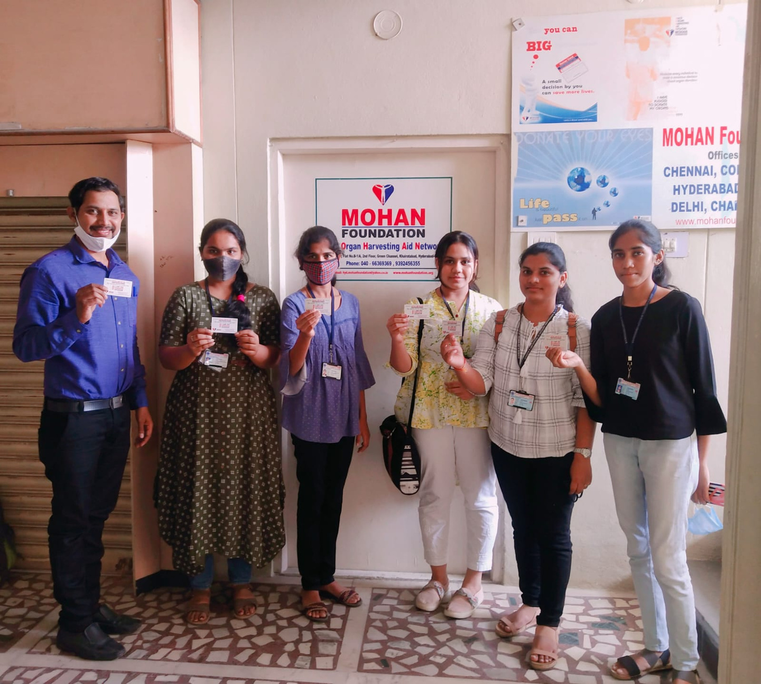

Slide 17
THANK YOU

